Slide 1

Exploratory Data Analysis
G2M insight for Cab investment firm
21.03.2023

Slide 2
General Information
XYZ firm is a private firm in US. We will help investors to make a right decision, is it worth to invest in this company
Goal: Identify spots that help to raise income.
Areas to investigate (Hypotheses Testing):
How does sex impact on the income?
How does the city impact on the income?
Does card or cash makes sense?
How does the income depends on day?

Slide 3

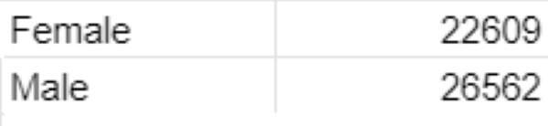

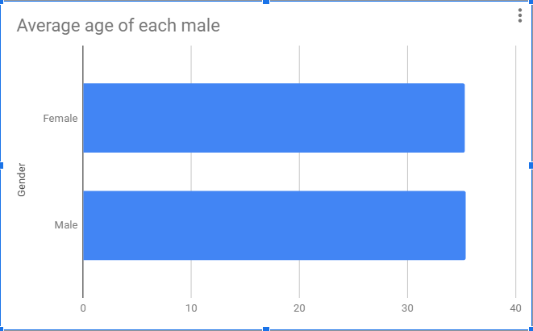
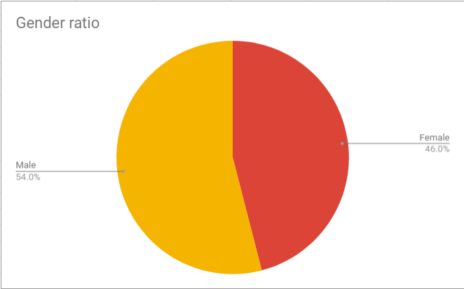
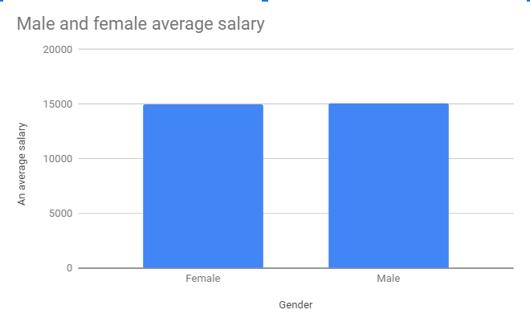
General information about genders

Slide 4
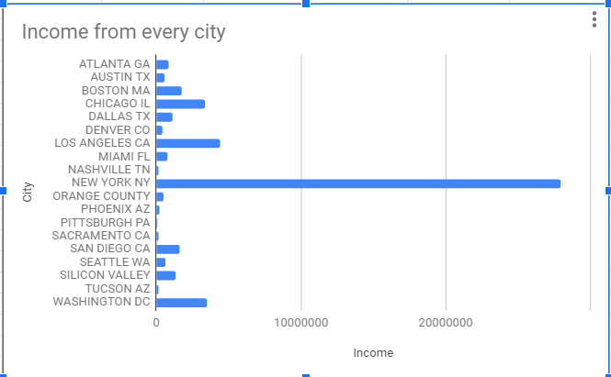
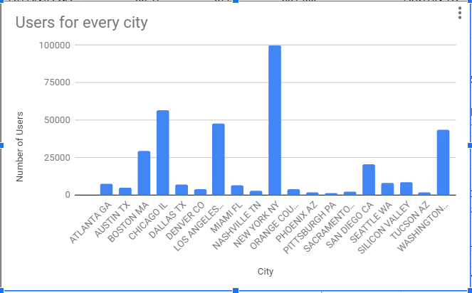
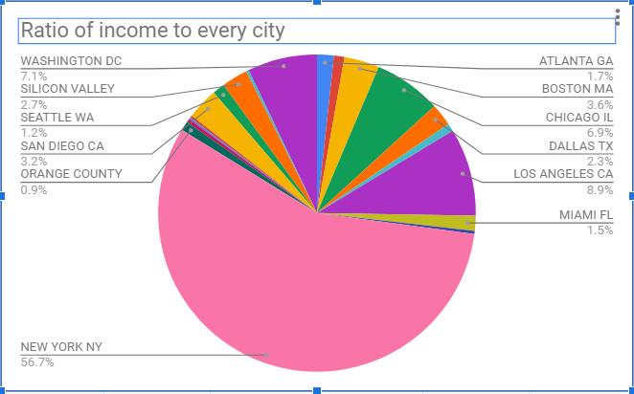
Cities Income

Slide 5



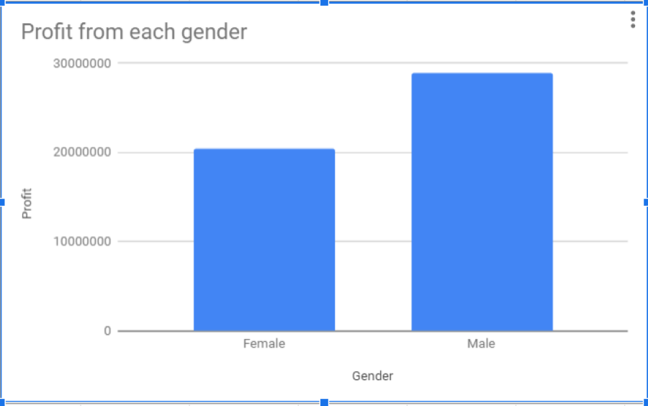
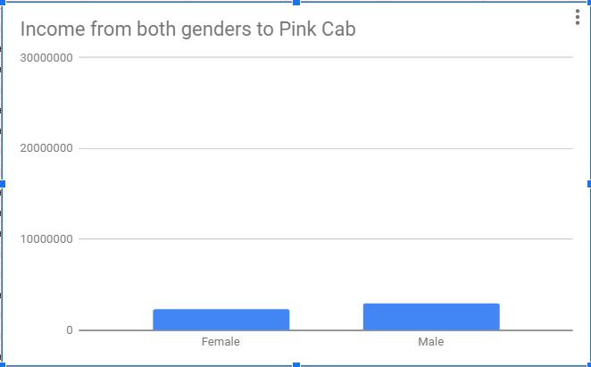
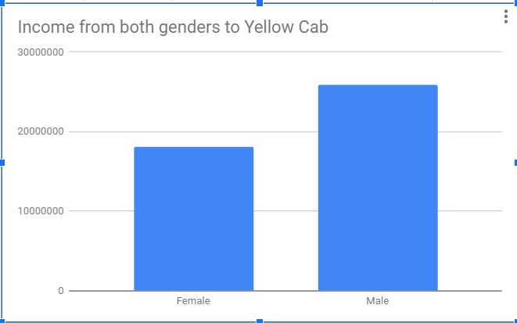
The impact of gender on business

Slide 6



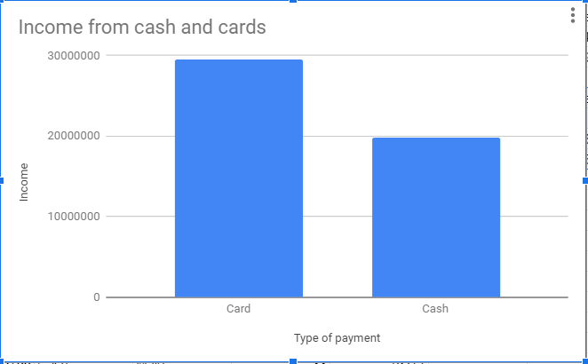
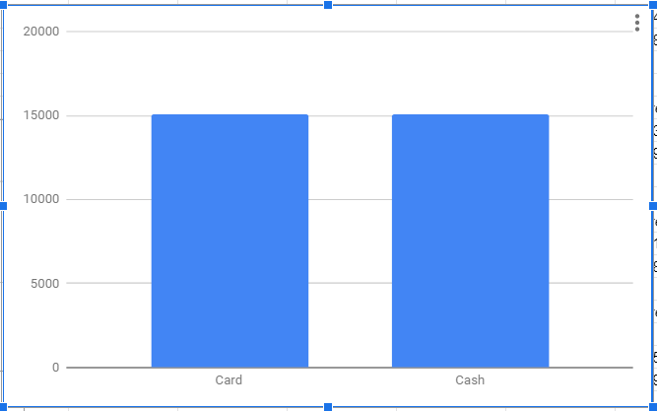
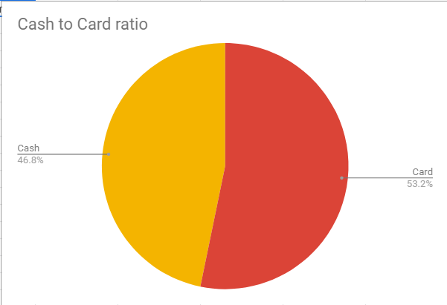
Card vs Cash

Slide 7
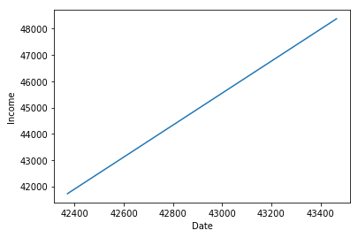
Prediction

Slide 8
Analysis
Men prefer to spend more money for this business, despite the fact that men have the same salary as women.
The most popular city for this business - New York City. This city takes more than 50% of the income. The only cities that have more than 25000 users are Boston, Chicago, Los Angeles, Washington and New York. I recommend to strengthen promotion of this business in 6 sites, mentioned above.
The income of card users slightly more than the income of cash payers.
The income rises during about 350 days to the peak, then falls to the income of the first day. And again the same rise of the income goes the next 350 days. Unstable income.

Slide 9
Thank You

